Slide 1
深度學習 Pytorch手把手實作-資料庫
義隆電子 人工智慧研發部 黃志勝

Slide 2
資料庫
1. 公開資料庫
UCI database,
MNIST,
ImageNet,
MS-COCO,… etc.
2. 私有資料庫

Slide 3
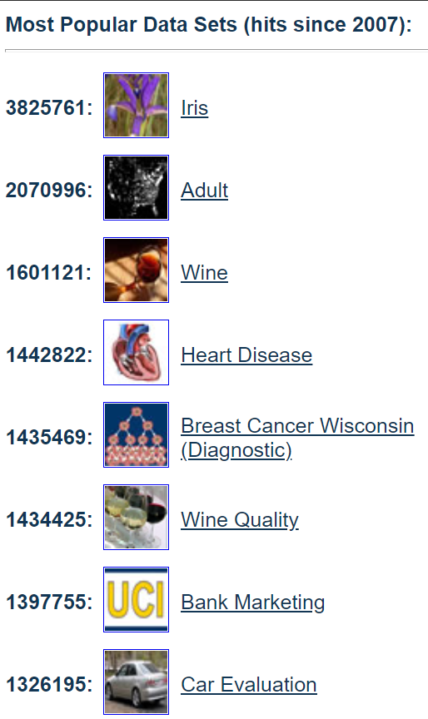
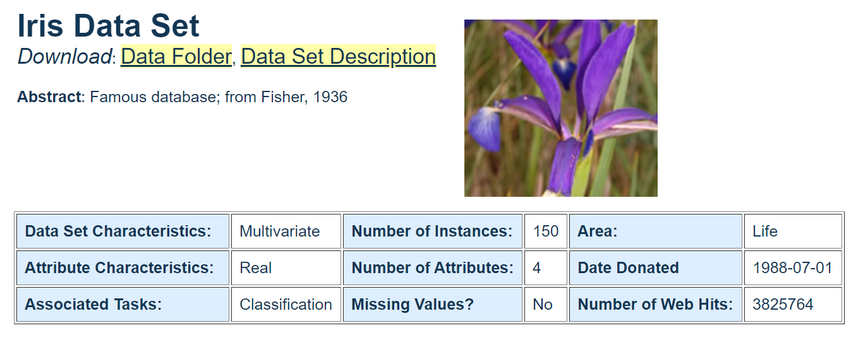
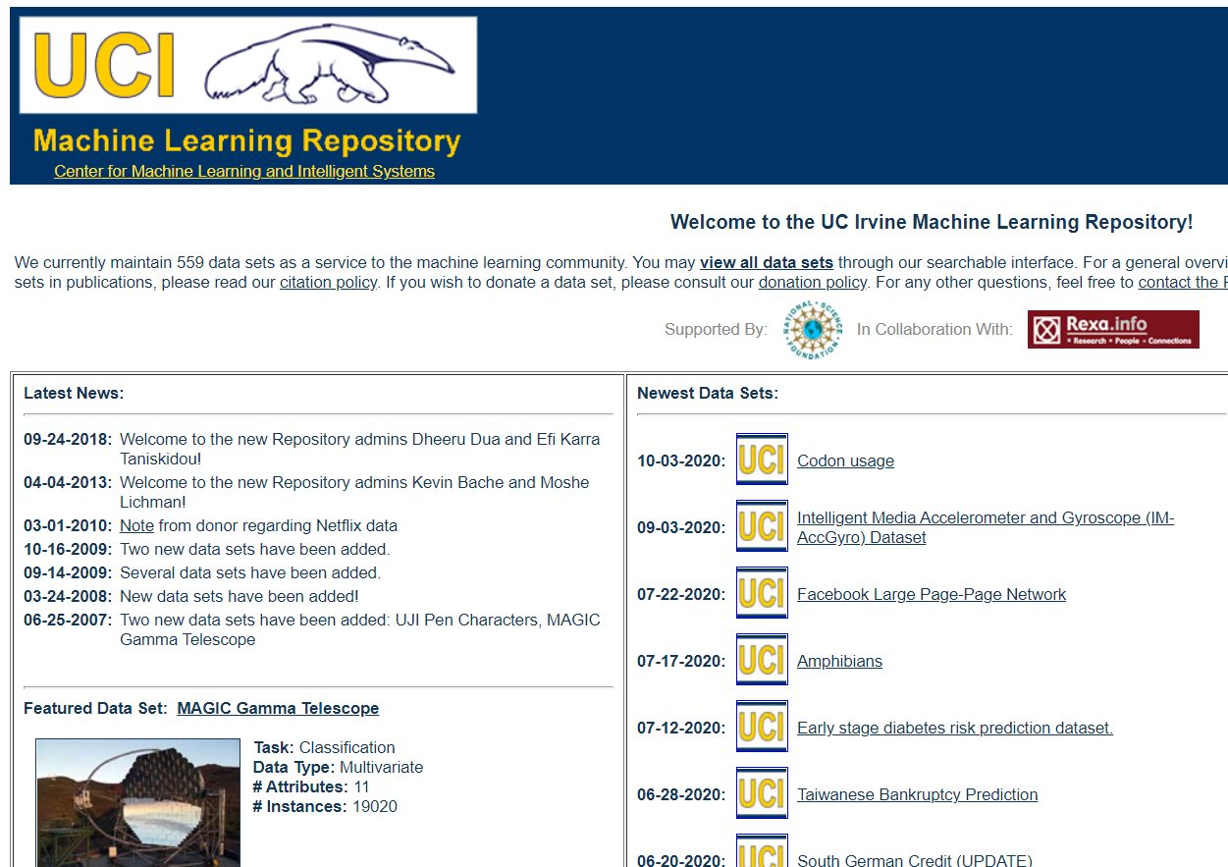
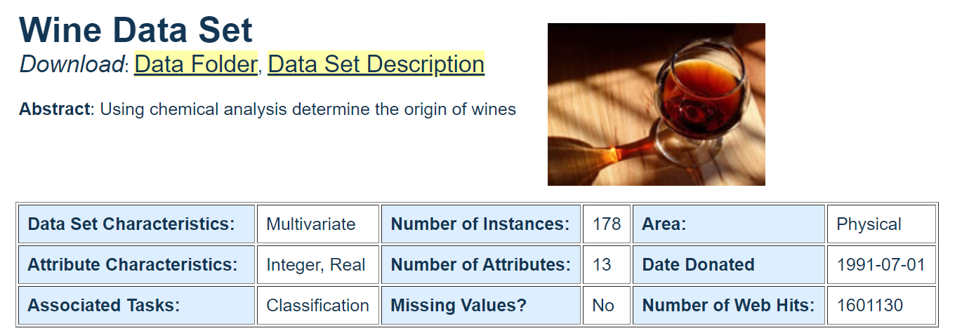
機器學習的資料庫
Link
1. UCI database
Link

Slide 4
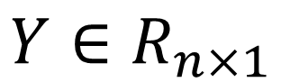
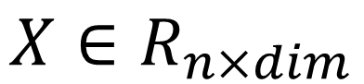
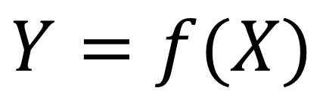
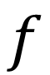
Learning Model
結構資料-learning model
data
Model
Target
$$X∈R_{n×dim}$$
$$f$$
$$Y∈R_{n×1}$$
$$Y=f(X)$$

Slide 5
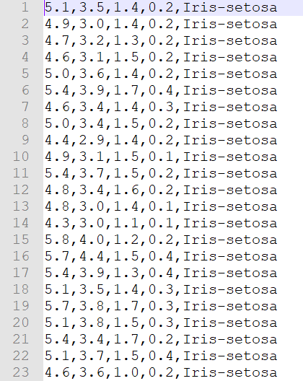
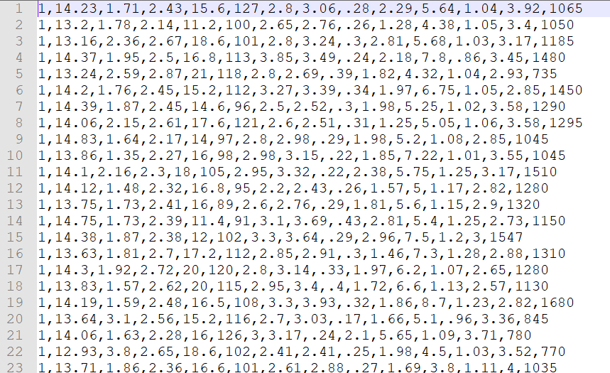
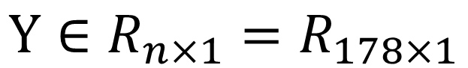
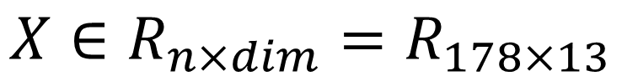
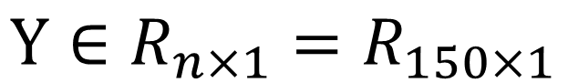
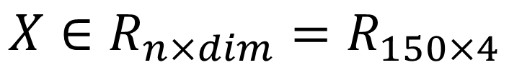
機器學習的資料庫 結構資料
IRIS
WINE
$$X∈R_{n×dim}=R_{150×4}$$
$$X∈R_{n×dim}=R_{178×13}$$
$$Y∈R_{n×1}=R_{150×1}$$
$$Y∈R_{n×1}=R_{178×1}$$

Slide 6
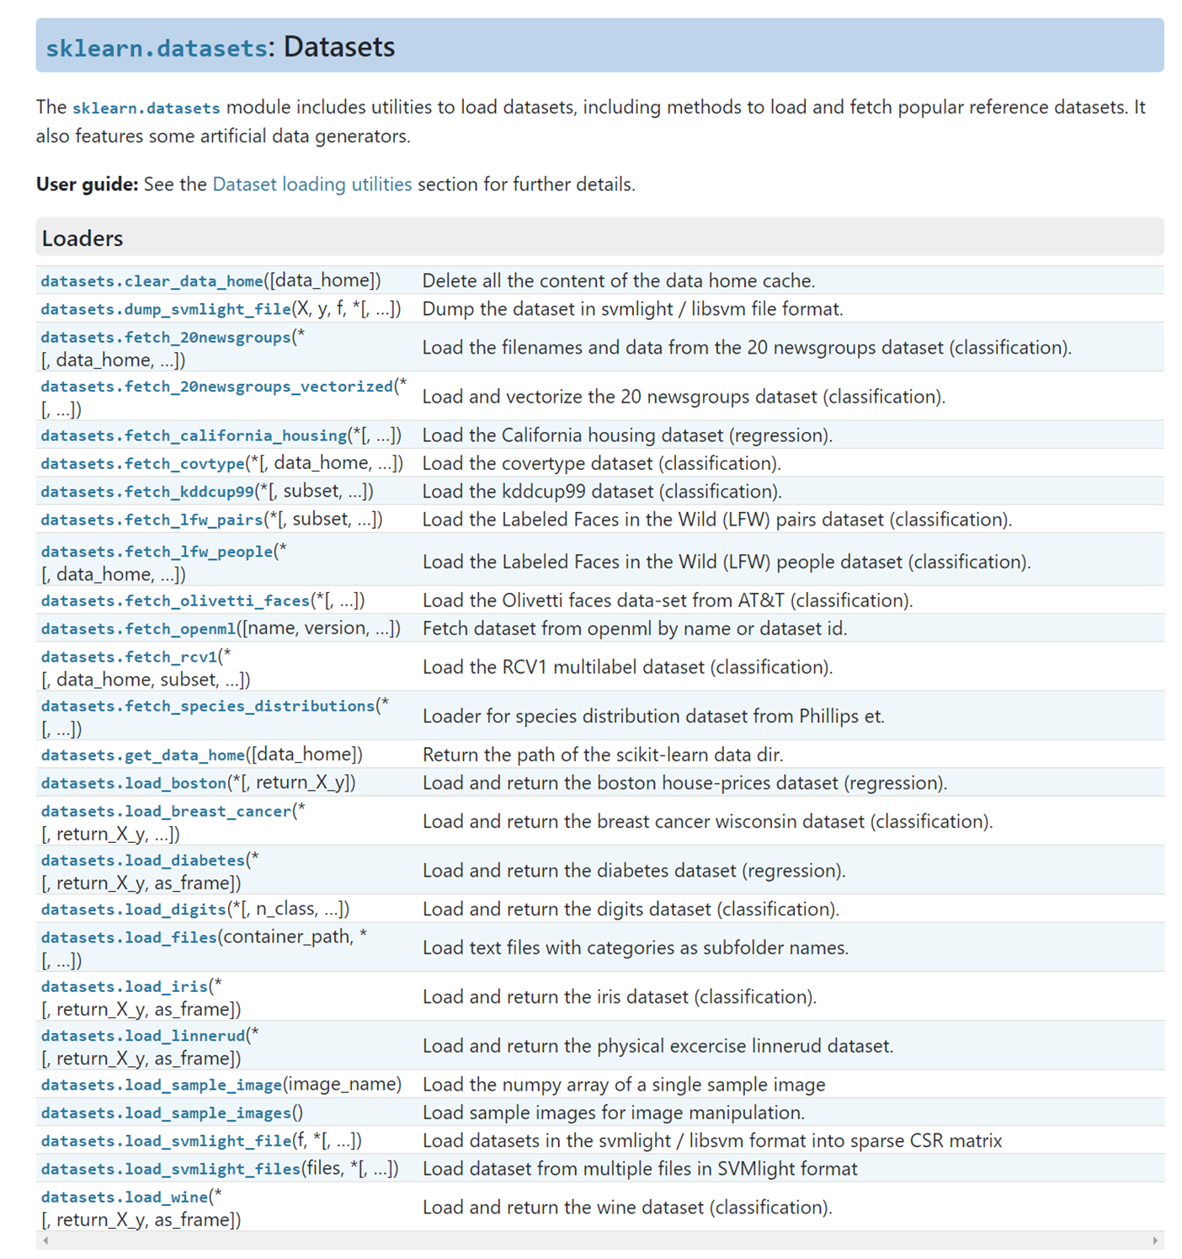
機器學習的資料庫
如果覺得要一個一個去下載和理解太麻煩。
Sklearn database
Notes:
https://scikit-learn.org/stable/modules/classes.html#module-sklearn.datasets

Slide 7
機器學習的資料庫
實際操作

Slide 8
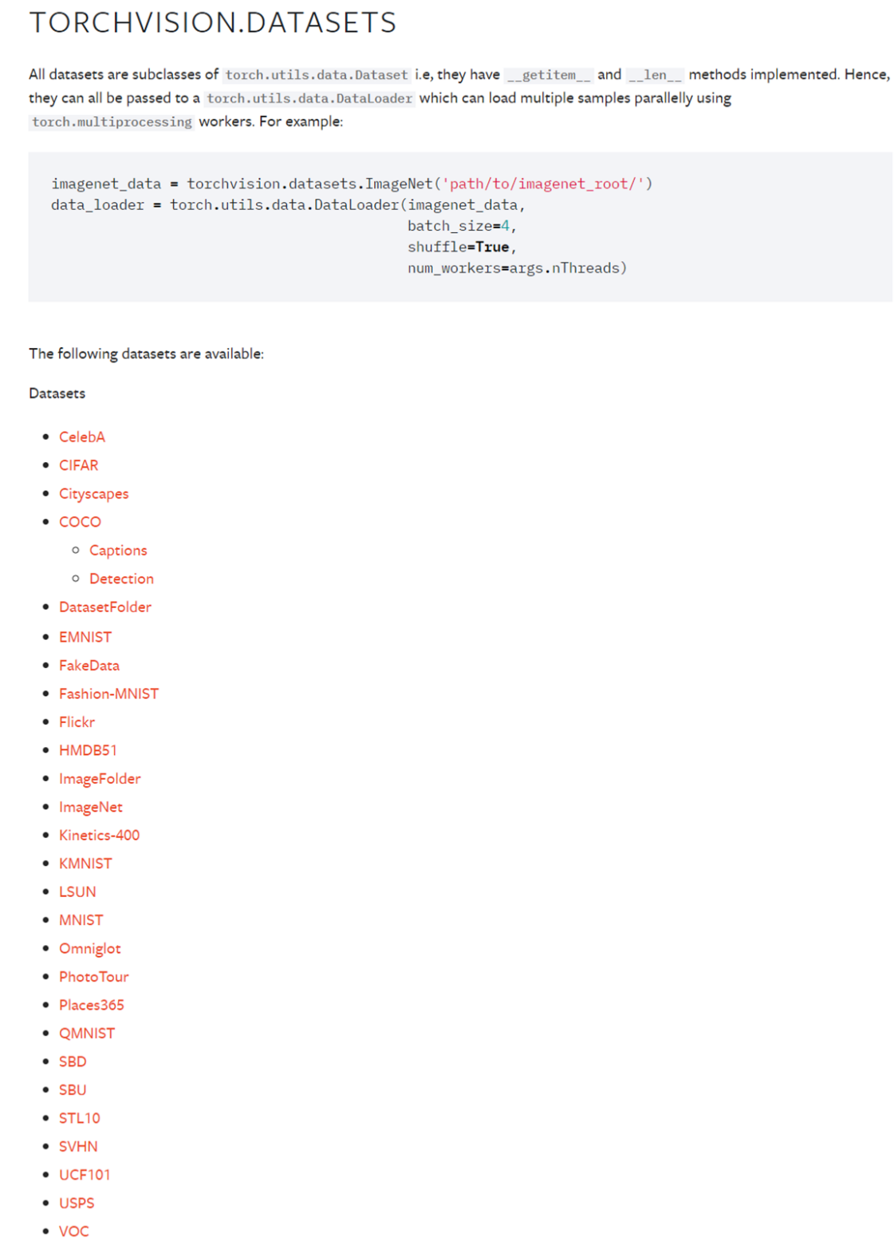
Pytorch資料庫
一般CV或是deep learning課程都以MNIST為課程範例資料庫。
Pytorch已經提供很好的協助資料庫下載的模組torchvision。
範例:
MNIST
CIFAR10

Slide 9
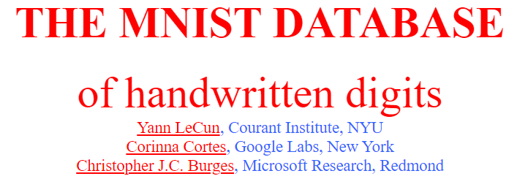
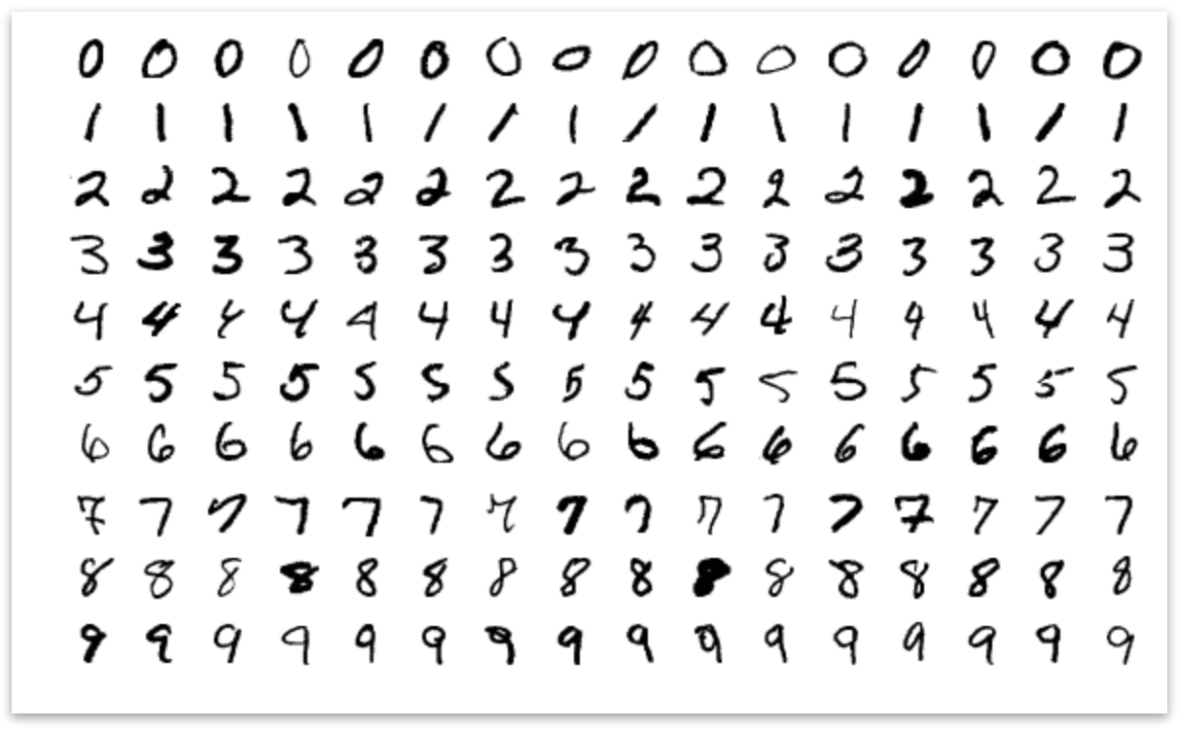
MNIST
MNIST: http://yann.lecun.com/exdb/mnist/
Training set: 60,000 (10,000 images per class)
Testing set:10,000 (1000 images per class)
Kaggle: https://www.kaggle.com/c/digit-recognizer

Slide 10
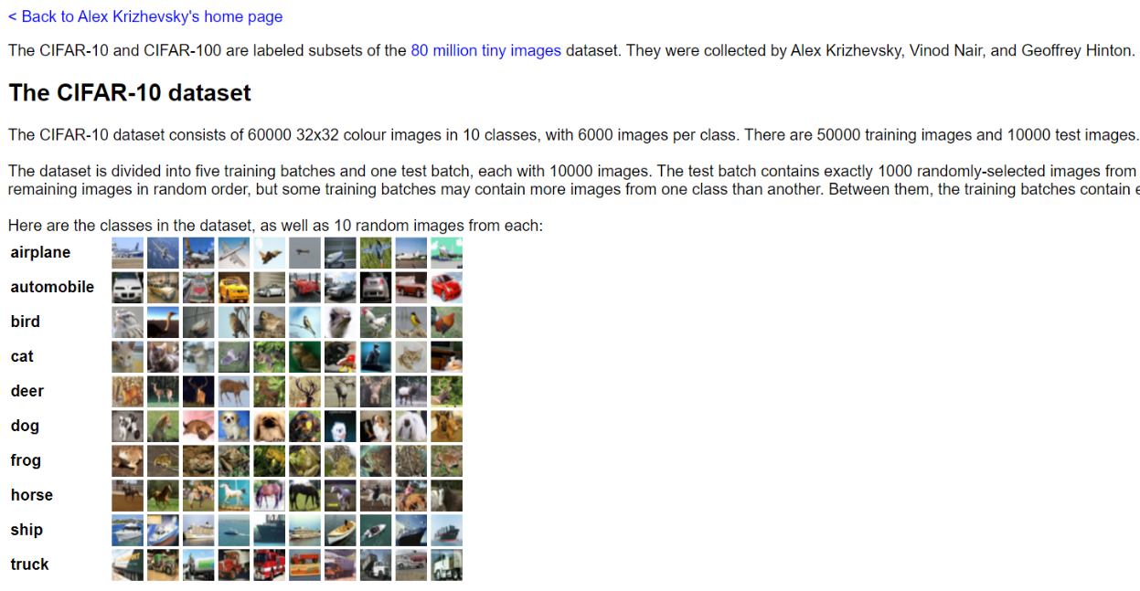
CIFAR-10
CIFAR10: https://www.cs.toronto.edu/~kriz/cifar.html
Training set: 50,000 with 10 classes (5000 images per class)
Testing set:10,000 (1000 images per class)

Slide 11
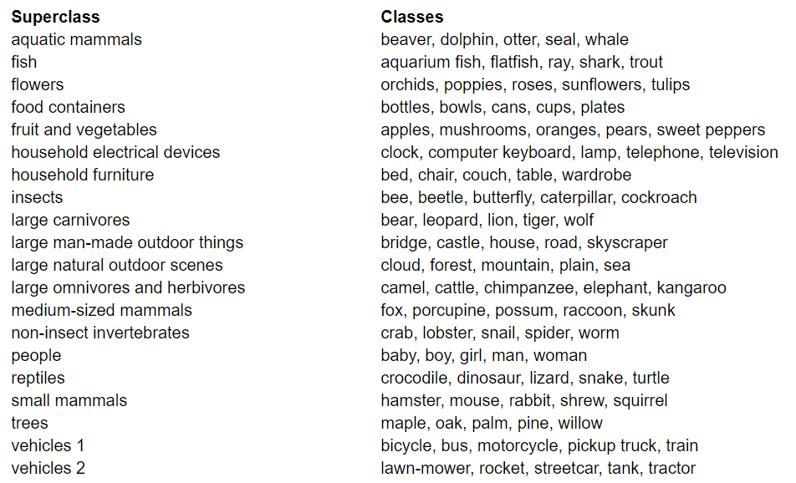
CIFAR-100
The CIFAR-100 dataset
This dataset is just like the CIFAR-10, except it has 100 classes containing 600 images each.
There are 500 training images and 100 testing images per class. The 100 classes in the CIFAR-100 are grouped into 20 superclasses.
Each image comes with a "fine" label (the class to which it belongs) and a "coarse" label (the superclass to which it belongs).

Slide 12
Pytorch資料庫
實際操作

Slide 13
其他公開資料庫
Kaggle: https://www.kaggle.com
PhysioNet: https://www.physionet.org/

Slide 14
私有資料庫
私有資料庫如何在pytorch內讀取。
我們將用kaggle內Image相關的圖庫進行實際操作
https://www.kaggle.com/datasets?topic=imageDataset
Car Brands Images: https://www.kaggle.com/yamaerenay/100-images-of-top-50-car-brands

Slide 15
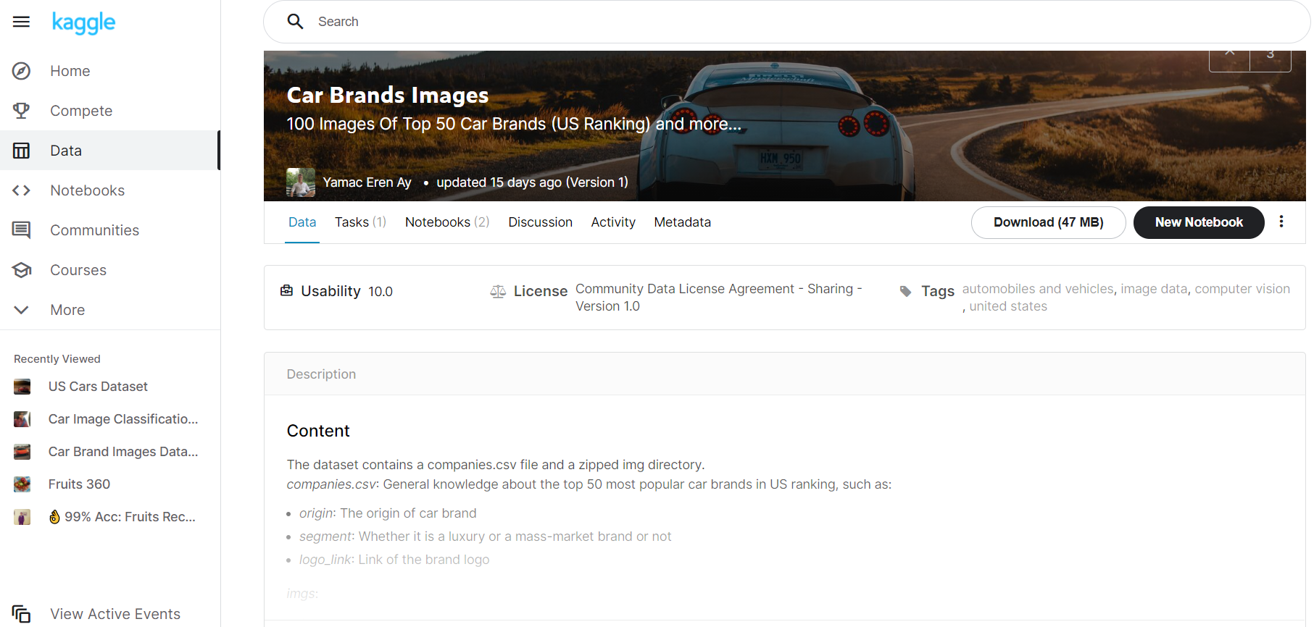
Car Brands Images
Build a Computer Vision model to predict whether a car image belongs to a luxury or mass-market car brand
Notes:
https://www.kaggle.com/yamaerenay/100-images-of-top-50-car-brands

